Slide 1


UTME VS PUTME
UTME VS PTUME EXAM
A comprehensive data analysis of students who participated in both exams, based on dataset of student scores.
UTME VS PUTME
Date: December 2025

Slide 2



INTRODUCTON
OBJECTIVE & QUESTIONS
METHOD & METRIC
KEY RESULTS
SUSPICIOUS PERFOMANCE SPIKE
STATISTICAL INTERPRETATION
RECOMMENDATION
1
2
3
4
5
6
7

Slide 3
INTRODUCTION
This analysis investigates the performance of students seeking admission into the Computer Science Department across four academic years (2022–2025). Each student participated in two major exams:
Analysis of UTME (strict CBT exam) & POST‑UTME (remote exam).
435 Computer Science applicants analyzed.
Goal: Evaluate reliability, fairness, and influence of both exams.

Slide 4


Our Goal
Measure Average on which Exam after Score.
Determine influence on admission scoring
Test relationship between UTME & POST‑UTME.
Which Exam is Suitable for basis of university admission.
What is the relationship between the same person taking UTME and PUTME, and does this make PUTME a good test of knowledge
Main Goal
To verify if low-UTME students are over-performing in Post-UTME and WHY.

Slide 5

Methods & Metrics
01
Descriptive statistics (averages).
Pie Chart
02
Logistic regression (influence)
Bar Chat
03
Pearson & Spearman correlation
Scatter Plot , Tread Line

Slide 6
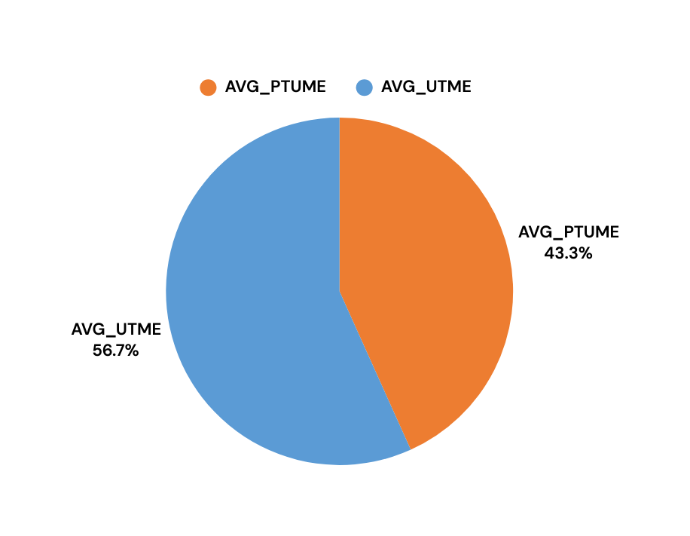
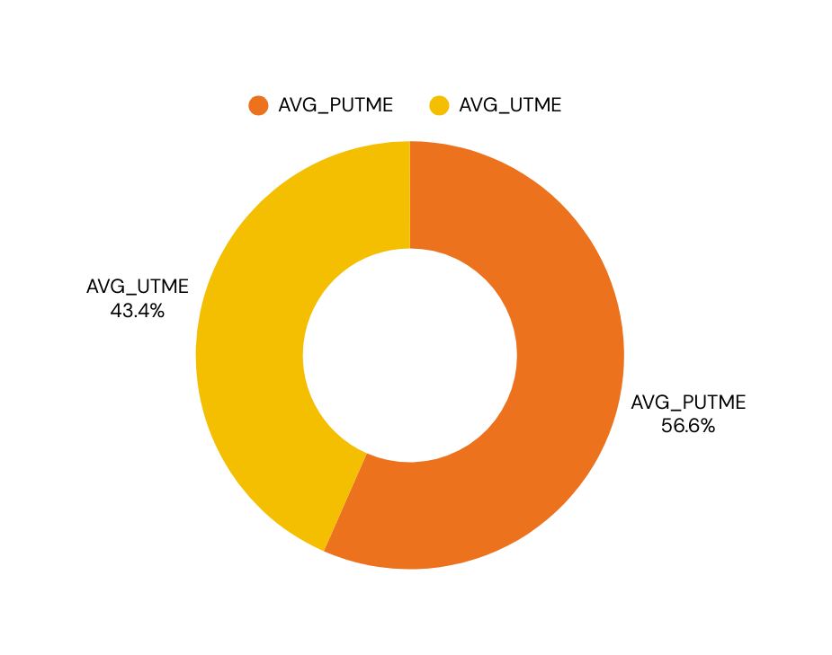
KEY RESULTS -
Contribution Both Exam Played in Total score
The descriptive analysis average shows the average contribution of UTME and PUTME in the total score that is used to gain admission. The total score for admission is calculated as UTME/8 + PUTME = Total score. If the total score is greater than or equal to 50, then the student gets admission.
DESCRIPTIVE ANALYSIS AVERAGE
COMPUTER SCIENCE
ELECTRICAL DEPARTMENT
PUTME scores significantly higher than UTME.

Slide 7
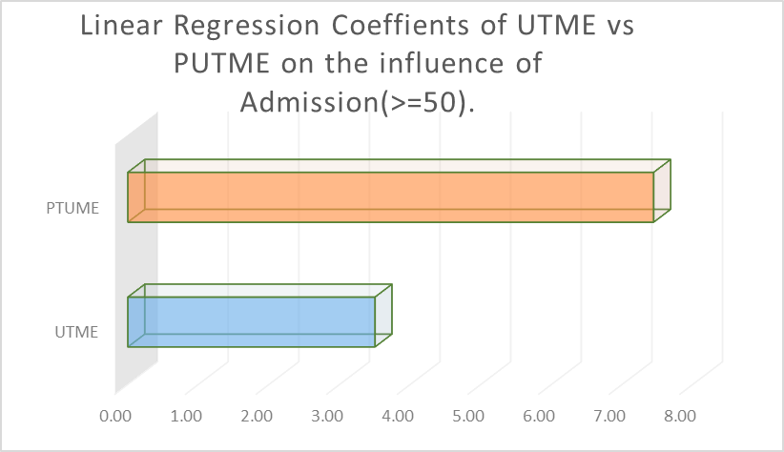
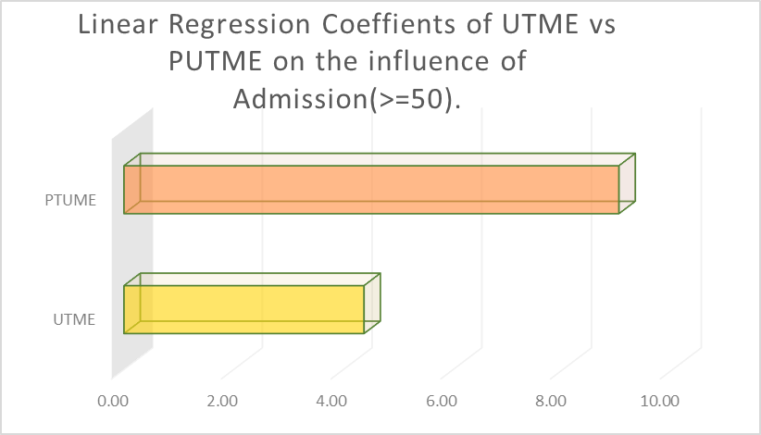
Key Results – Logistic Regression
COMPUTER SCIENCE
Coeffient | Influence
Intercept | 3.974905268
b0(UTME) | 3.49959444074845
b1(PUTME) | 7.44557593298092
ELECTRICAL DEPARTMENT
Coeffient | Influence
Intercept | 3.685336
b0(UTME) | 4.374758
b1(PUTME) | 9.0201

Slide 8
Correlation Analysis
COMPUTER SCIENCE
Pearson: 0.013 → No linear relationship
Spearman: –0.0395 → No rank relationship
UTME scores do not predict PUTME performance.
The two exams behave like independent exams.
High UTME ≠ High POST‑UTME
Low UTME ≠ Low POST‑UTME
UTME scores do not predict PUTME performance.
The two exams behave like independent exams.
High UTME ≠ High POST‑UTME
Low UTME ≠ Low POST‑UTME

Slide 9
Correlation Analysis
ELECTRICAL DEPARTMENT
Pearson: 0.1302 → little linear relationship
Spearman: 0.1181 → little linear relationship
UTME scores do not predict PUTME performance.
The two exams behave like independent exams.
High UTME ≠ High POST‑UTME
Low UTME ≠ Low POST‑UTME
A very weak positive relationship
A correlation of 0.13 means:
Only about 1.4% of PUTME performance can be explained by UTME performance
98.6% is unexplained and random

Slide 10
Suspicious Performance Spike
COMPUTER SCIENCE
The Spike you see in the ScatterPlot is NOT normal.
IT IS THE STRONGEST VISUAL EVIDENCE SUPPORTING OUR MAIN HYPOTHESIS
“STUDENTS WHO PERFORM POORLY IN UTME OFTEN PERFORM UNUSUALLY HIGH IN PUTME.”
Low-Performing UTME Students Suddenly Become Top Scorers in PUTME. These patterns are not random; it's a repeated trend. The spike is too frequent to be normal academic improvement. In a real exam system, this shouldn’t happen so consistently. Normally, if you're weak in UTME (hard & supervised), you should also struggle in PUTME (same CBT style). But in our case, the analysis and scatter plot prove the opposite: students who struggle in UTME do very well in the PUTME exam.
A logical explanation for the pattern is the absence of supervision during the Post-UTME exam, which creates opportunities for students to inflate their scores through dishonest means.
WHY ?
Other Explaination
Different exam difficulty
Content mismatch
Invalid test environment

Slide 11
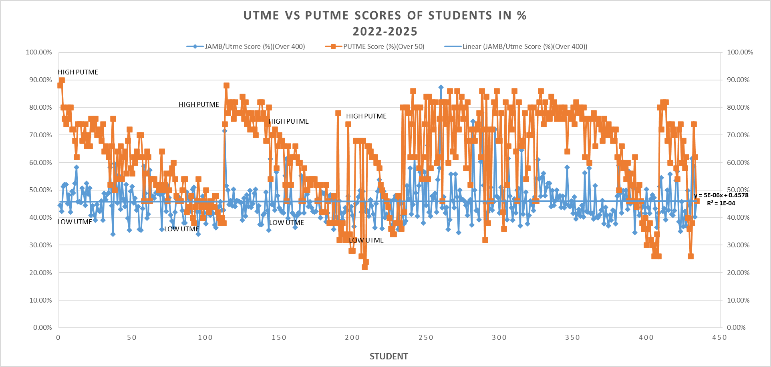
COMPUTER SCIENCE SCATTER PLOT

Slide 12
Suspicious Performance Spike
ELECTRICAL ENGINERRING
The Spike you see in the ScatterPlot is NOT normal.
IT IS THE STRONGEST VISUAL EVIDENCE SUPPORTING OUR MAIN HYPOTHESIS
“STUDENTS WHO PERFORM POORLY IN UTME OFTEN PERFORM UNUSUALLY HIGH IN PUTME.”
Low-Performing UTME Students Suddenly Become Top Scorers in PUTME. These patterns are not random; it's a repeated trend. The spike is too frequent to be normal academic improvement. In a real exam system, this shouldn’t happen so consistently. Normally, if you're weak in UTME (hard and supervised), you should also struggle in PUTME (same CBT style). But in our case, the analysis and scatter plot prove the opposite: students who struggle in UTME do very well in the PUTME exam.
A logical explanation for the pattern is the absence of supervision during the Post-UTME exam, which creates opportunities for students to inflate their scores through dishonest means.
WHY ?
Other Explaination
Different exam difficulty
Content mismatch
Invalid test environment

Slide 13
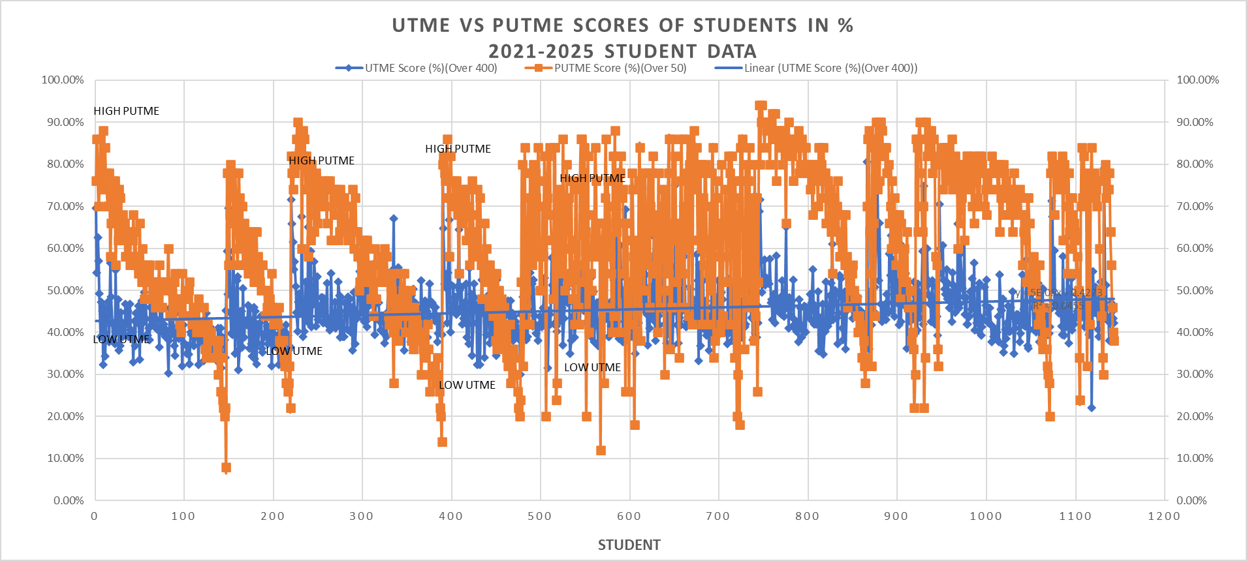
ELECTRICAL SCATTER PLOT

Slide 14

Statistical Interpretation
POST‑UTME is not a reliable academic measure.
UTME is more consistent and stable.
POST‑UTME likely inflated due to weak supervision.
R²≈0 → No predictive power between the two exams.

Slide 15
Conclusion
UTME remains stable and reliable as the basis for university admission.
The relationship between the same student taking UTME and POST-UTME shows no consistency or correlation.
This proves that POST-UTME, when taken without supervision, is not a reliable test of knowledge.
UTME remains the stronger and more valid exam for measuring academic strength.
The influence each exam (UTME vs POST-UTME) has on admission for a 4-year dataset in Computer Science and a 5-year dataset in Electrical Engineering is HEAVILY ON THE SIDE OF POST-UTME, AS SEEN IN THE PREVIOUS CHART.

Slide 16
RECOMMENDATION
Full Screen Recording
Mandatory webcam proctoring
Verify identity
Monitor behavior
Keystroke behavior tracking
Move exam to supervised CBT centers

Slide 17
Thank
you

